Slide 1
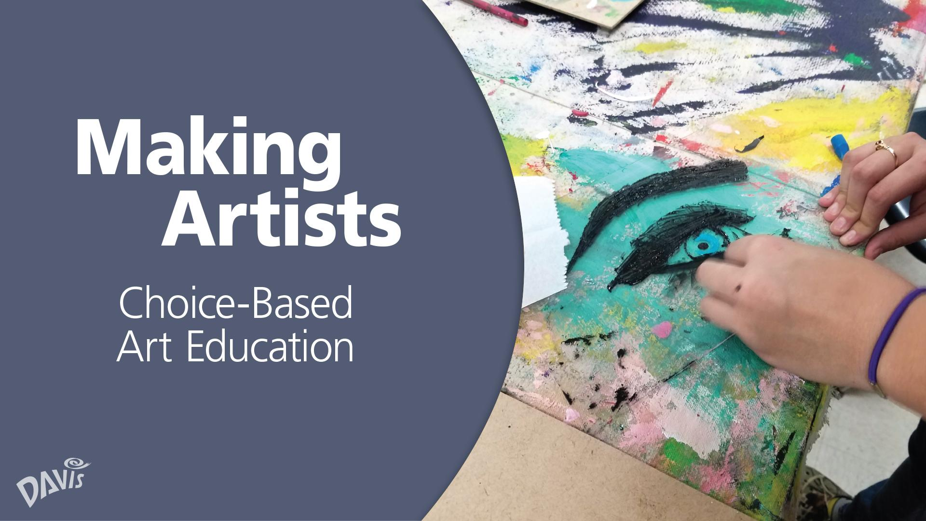

Slide 2
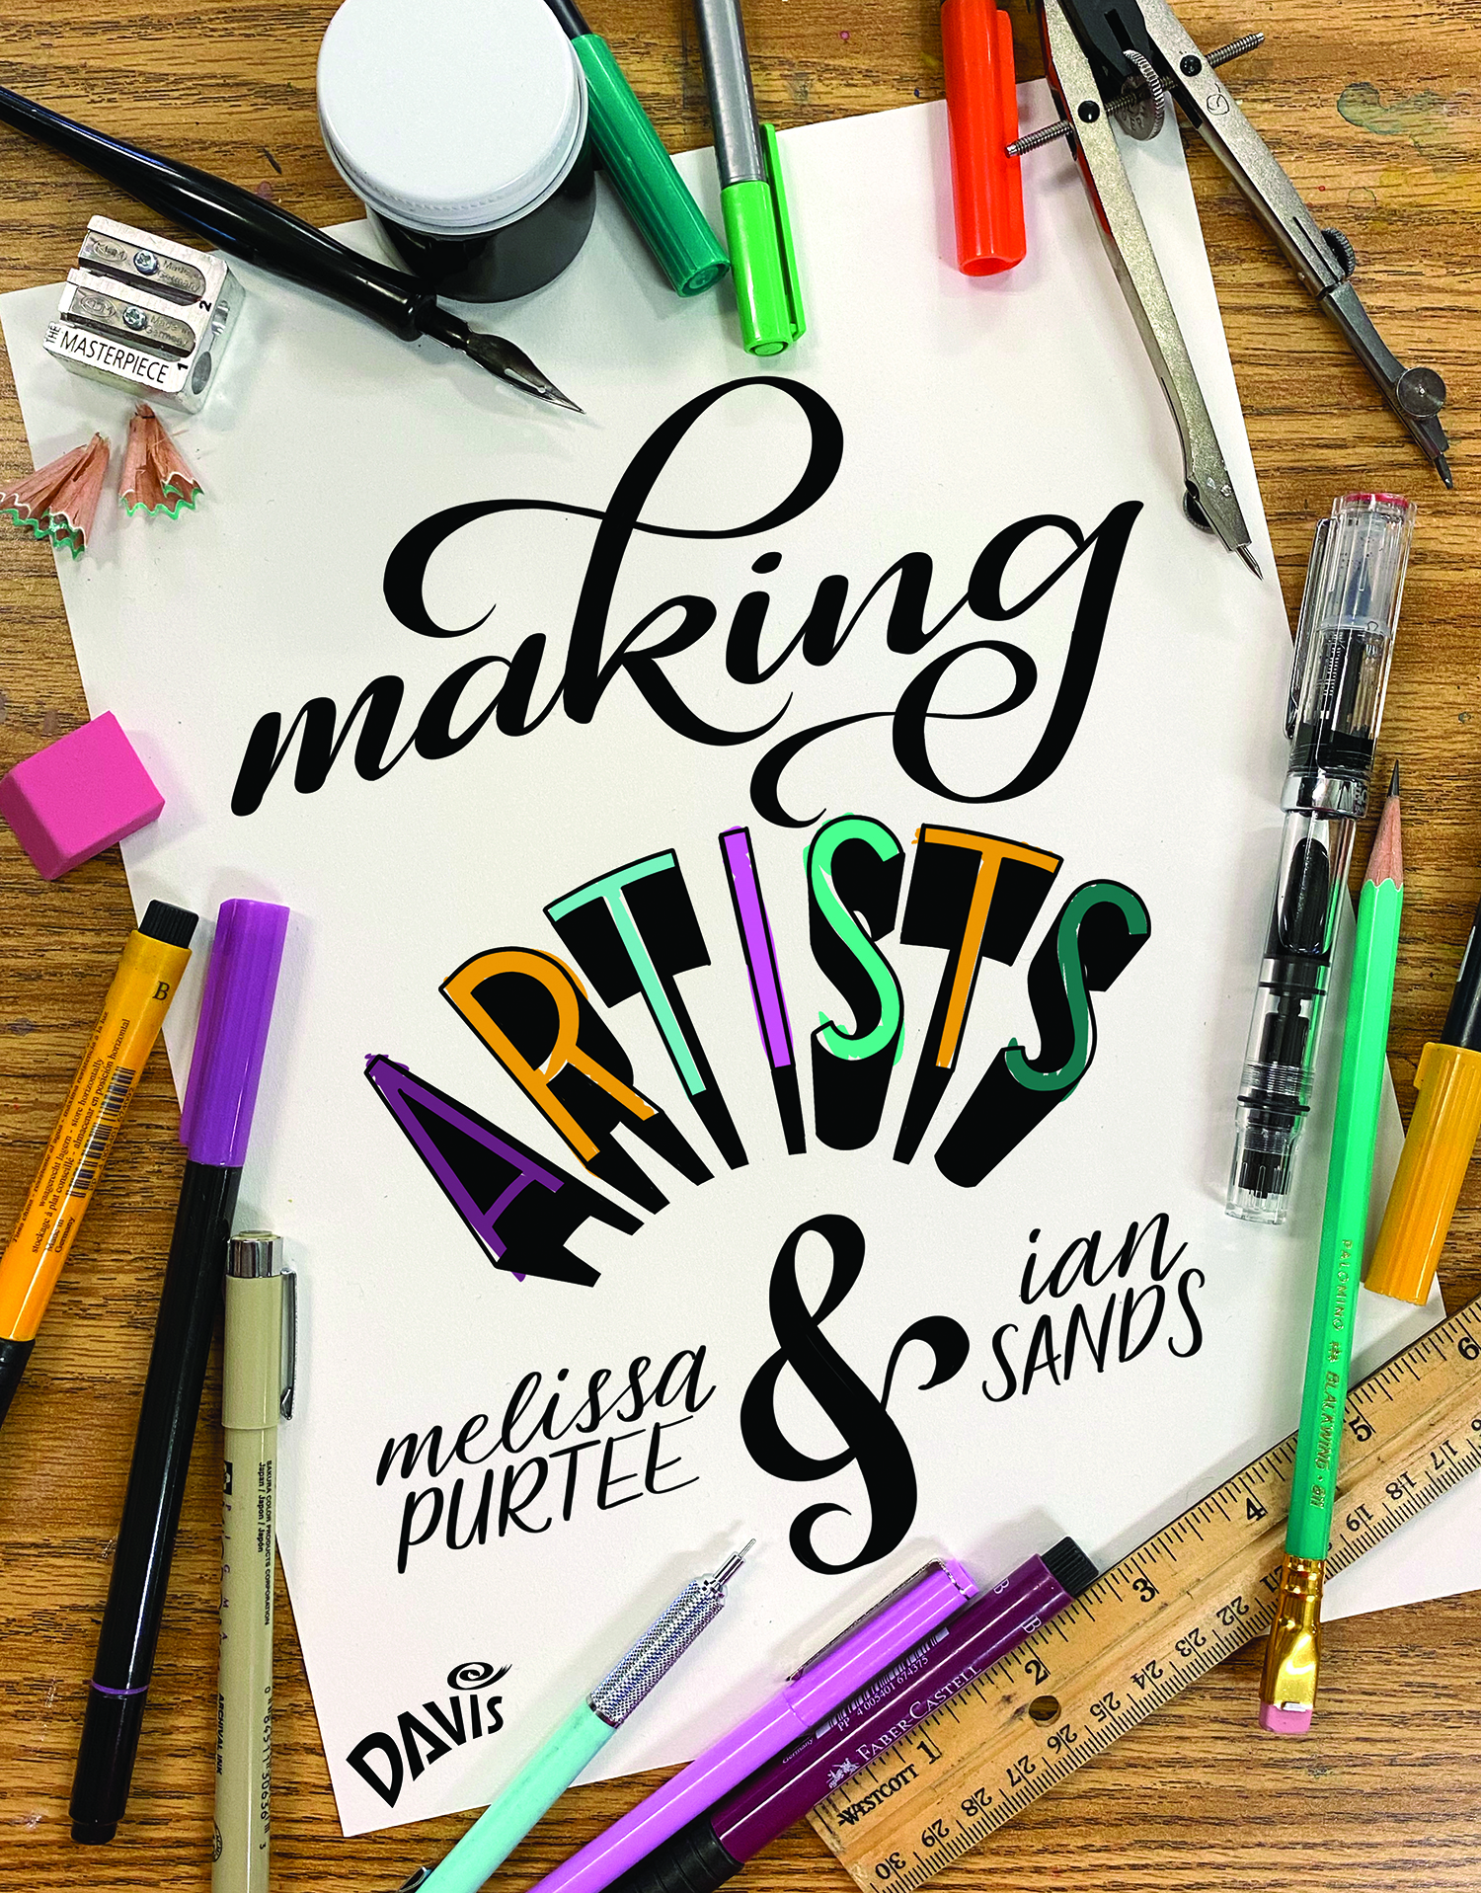
Questions for Melissa & Ian
Type your questions in the chat box.
Learn more about Making Artists at
DavisArt.com/MakingArtists

Slide 3
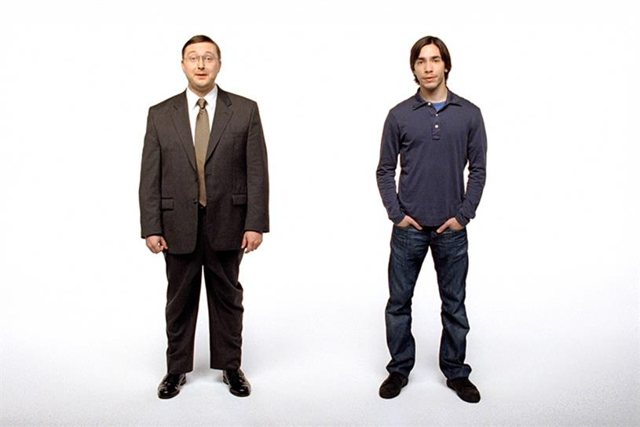

Slide 4
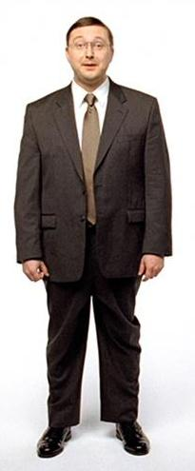
Making Art
Project
Technique/Media
Theme/Concept
Process

Slide 5
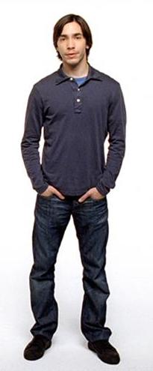
Making Artist
Process
Theme/Concept
Technique/Media
Project

Slide 6
Making Art
Making Artist
Project
Process
Technique/Media
Theme/Concept
Theme/Concept
Technique/Media
Process
Project

Slide 7
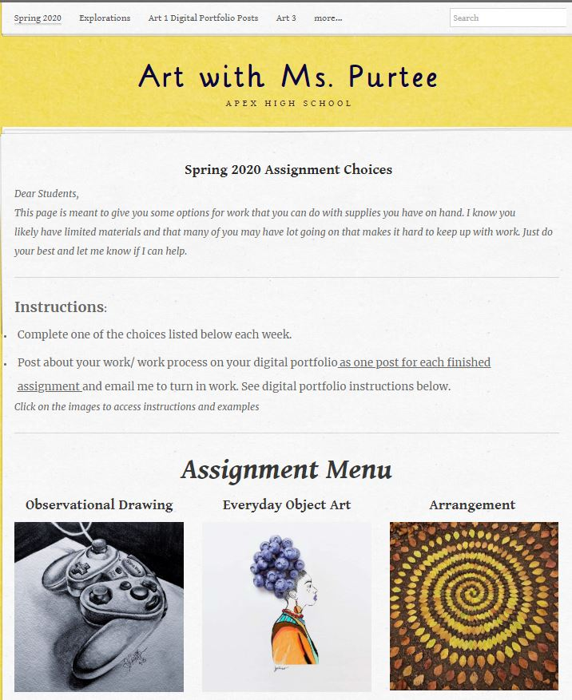
Melissa’s Digital Learning Site
www.purtee.weebly.com

Slide 8
The Nine

Slide 9
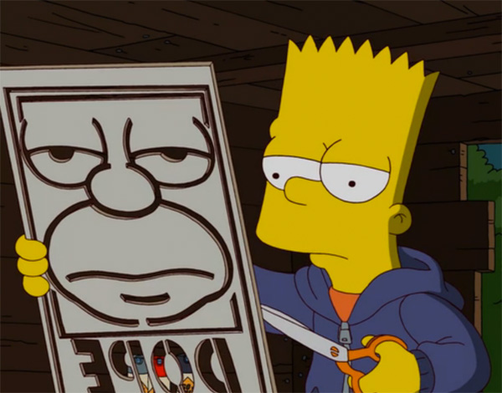
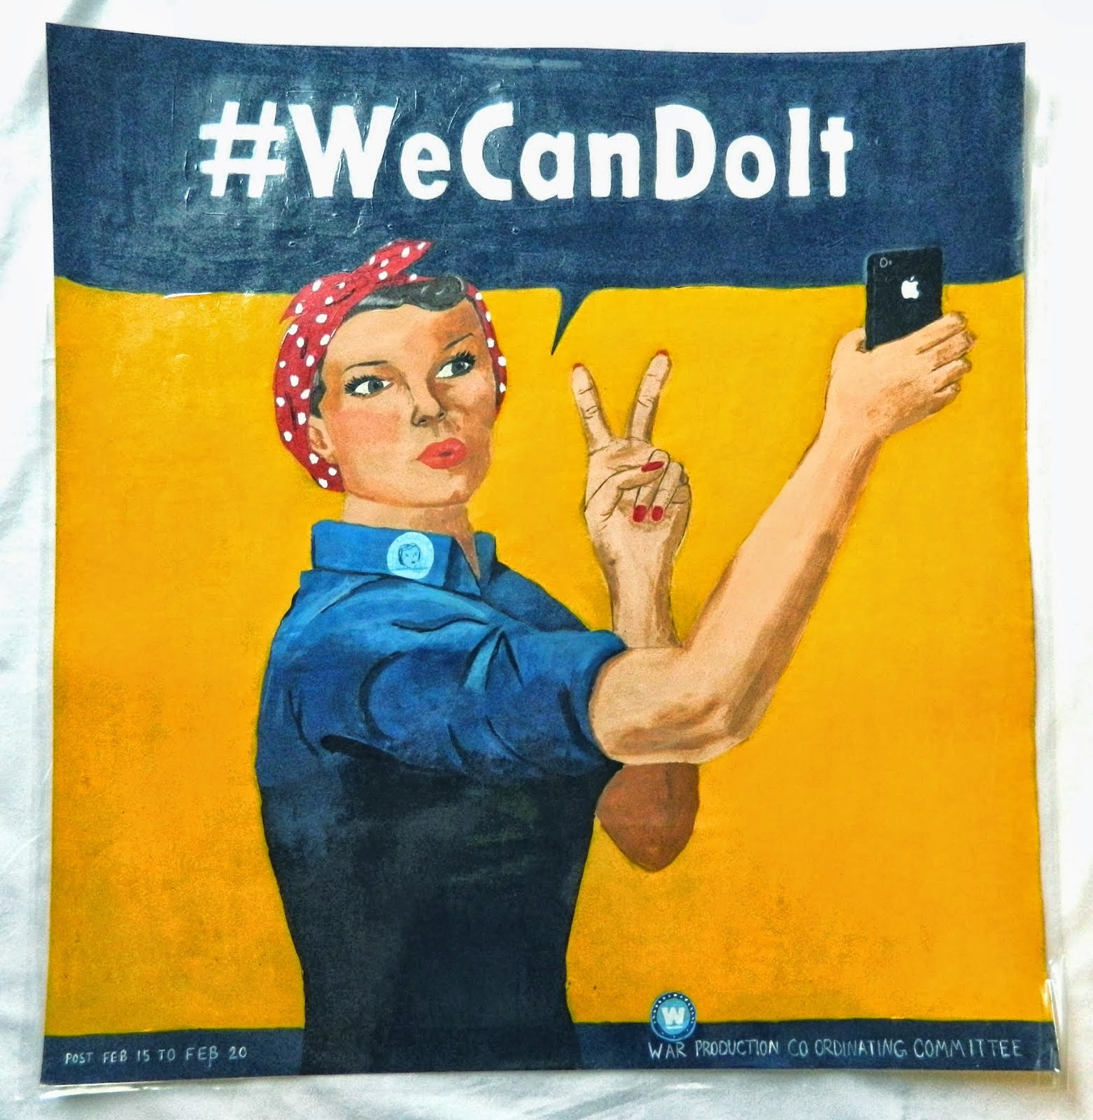
Artistic Behavior Units
Unit Title: Artists Steal
Objective:
Understand how Artists use Appropriation by Borrowing aspects of other artworks and incorporating it into their Own Work.

Slide 10
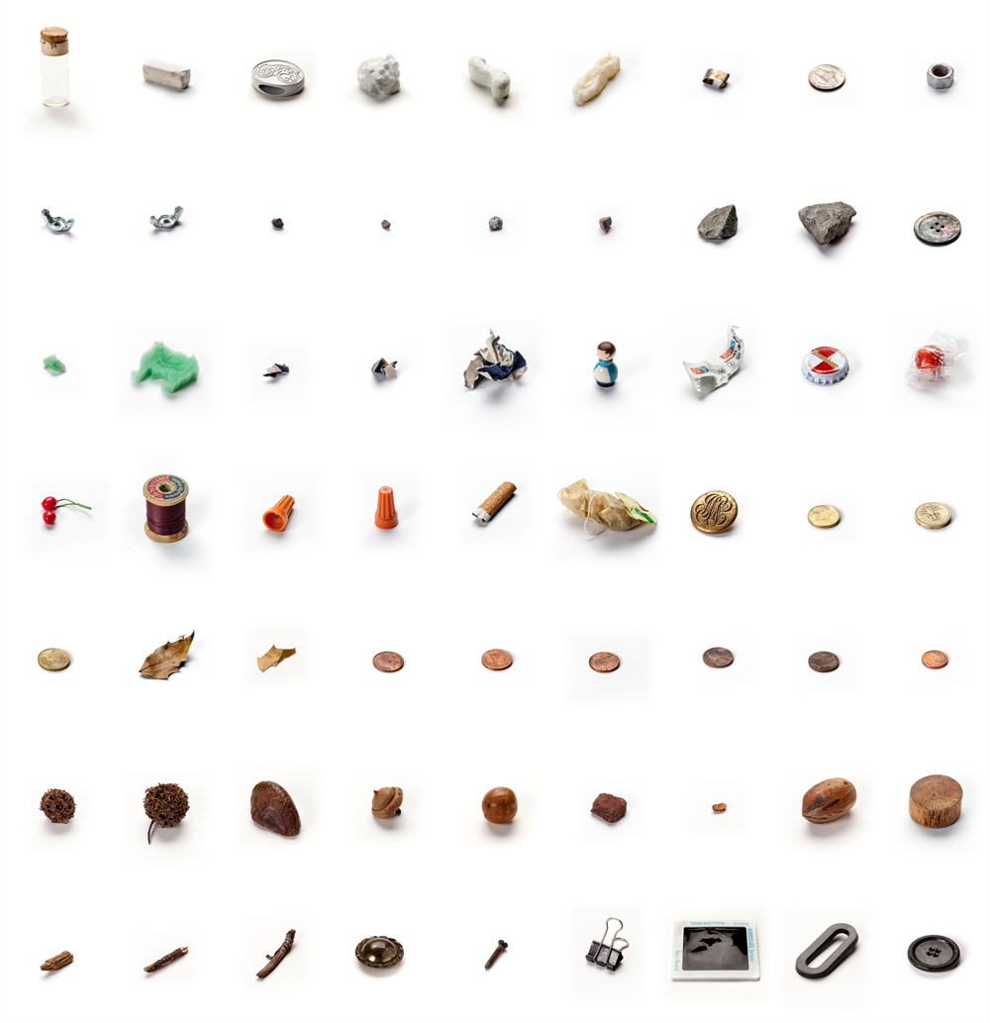
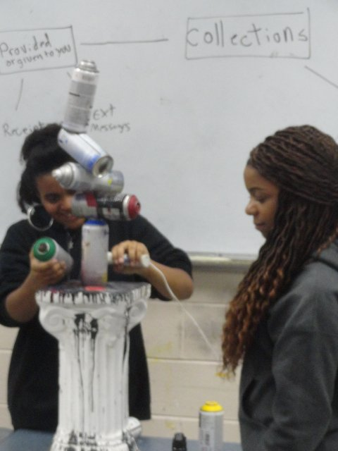
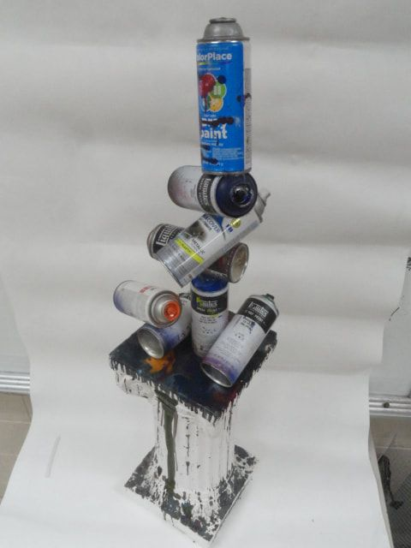
Artistic Behavior Units
Unit Title: Collect & Synthesize
Objective:
Create a meaningful work of Art
by Synthesizing a Collection
Lenka Clayton: 63 Objects Taken From My Son’s Mouth

Slide 11
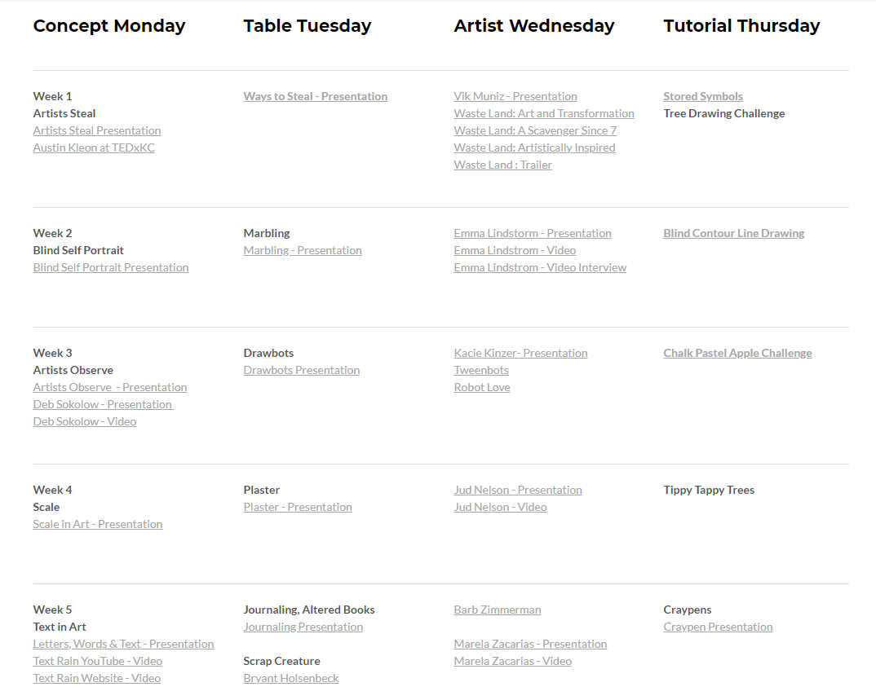
Modular

Slide 12
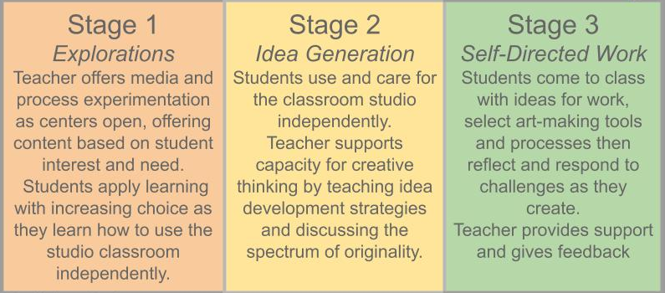
Scaffolding for a Student Directed Studio
By Melissa Purtee

Slide 13
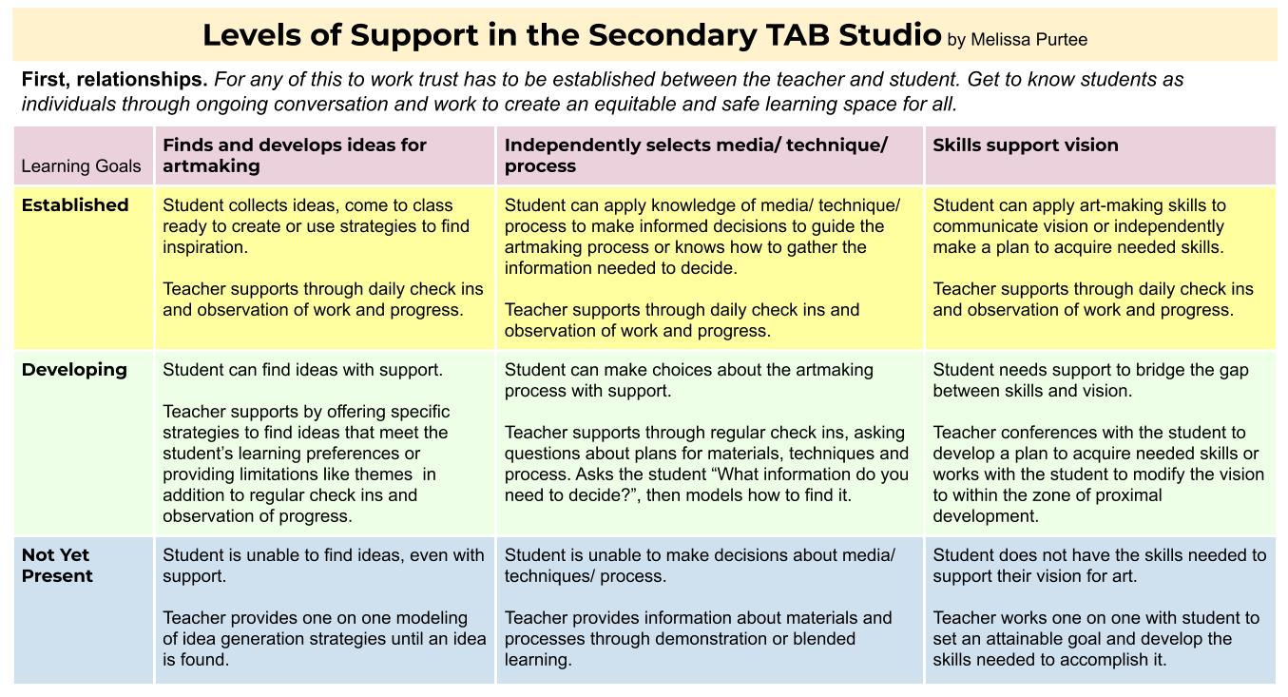

Slide 14
Studio Practice Assessment
Look for and/or ask about indicators of these three essential practices.
Provide differentiated support when student understanding falls short of the goal
By Melissa Purtee

